Slide 1


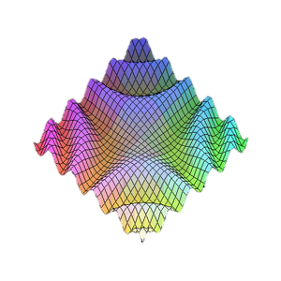

JavaScript Patterns
Private/Public fields, Module, Revealing Module
Telerik Software Academy
Learning & Development Team
http://academy.telerik.com

Slide 2

Table of Contents
Public/Private fields in JavaScript
Module pattern
Pros and cons
Structure
Live demo
Revealing module
Pros and cons
Structure
Live demo

Slide 3
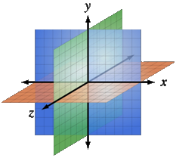
Public/Private fields
Using the function scope

Slide 4
Public/Private Fields
Each variable is defined:
In the global scope (Public)
In a function scope (Private)
var global = 5;
function myFunction() {
var private = global;
function innerFunction(){
var innerPrivate = private;
}
}

Slide 5

Public/Private fields
Live Demo

Slide 6
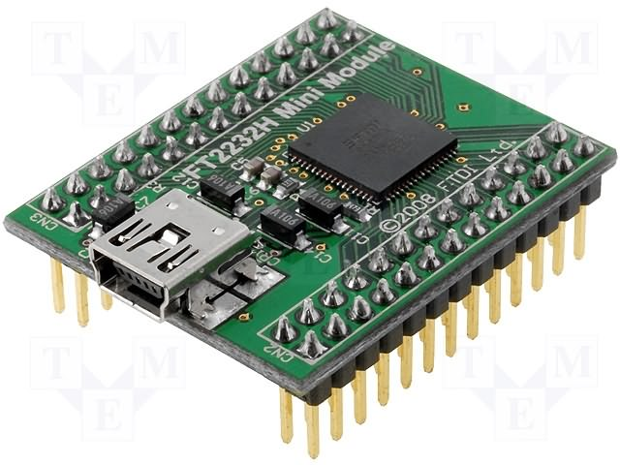
The Module Pattern
Hide members

Slide 7
Pros and Cons
Pros:
“Modularize” code into re-useable objects
Variables/functions not in global namespace
Expose only public members
Cons:
Functions may be duplicated across objects in memory
Not easy to extend
Some complain about debugging

Slide 8
Structure
Structure:
var module = (function() {
//private variables
//private functions
return {
//public members
};
});
Usage
With the new keyword

Slide 9
Example
Example:
var Calculator = (function(eq) {
var eqCtl = document.getElementById(eq);
return {
add: function(x,y) {
var val = x + y;
eqCtl.innerHTML = val;
}
};
});
var calculator = new Calculator('eq'); calculator.add(2,2);

Slide 10
Summary
Module pattern provides encapsulation of variables and functions
Provides a way to add visibility (public versus private) to members
Each object instance creates new copies of functions in memory
Extending objects can be difficult since no prototyping is used

Slide 11

Module Pattern
Live Demo

Slide 12

The Revealing Module Pattern
Reveal the most interesting
members

Slide 13
Pros and Cons
Pros:
“Modularize” code into re-useable objects
Variables/functions taken out of global namespace
Expose only public members
"Cleaner" way to expose public members
Cons:
Functions may be duplicated across objects in memory when not using singleton
Not easy to extend
Some complain about debugging

Slide 14
Structure
Structure:
var module = function() {
//private variables
//private functions
return {
//public members
};
}();
Usage
Without the new keyword

Slide 15
Example
Example:
var calculator = function(eq) {
var eqCtl = document.getElementById(eq),
doAdd = function(x,y) {
var val = x + y;
eqCtl.innerHTML = val;
};
return {
add: doAdd
}; //Expose public member
}('eqCtl');
calculator.add(2,2);

Slide 16
Summary
Module pattern provides encapsulation of variables and functions
Provides a way to add visibility (public versus private) to members
Each object instance creates new copies of functions in memory
Extending objects can be difficult since no prototyping is used

Slide 17
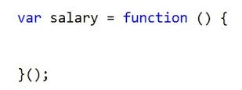
Revealing Module Pattern
Live Demo

Slide 18

Extending Existing Module
Live Demo

Slide 19

Arrays
http://csharpfundamentals.telerik.com

Slide 20
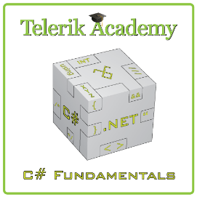



Free Trainings @ Telerik Academy
“C# Programming @ Telerik Academy
csharpfundamentals.telerik.com
Telerik Software Academy
academy.telerik.com
Telerik Academy @ Facebook
facebook.com/TelerikAcademy
Telerik Software Academy Forums
forums.academy.telerik.com

Slide 21
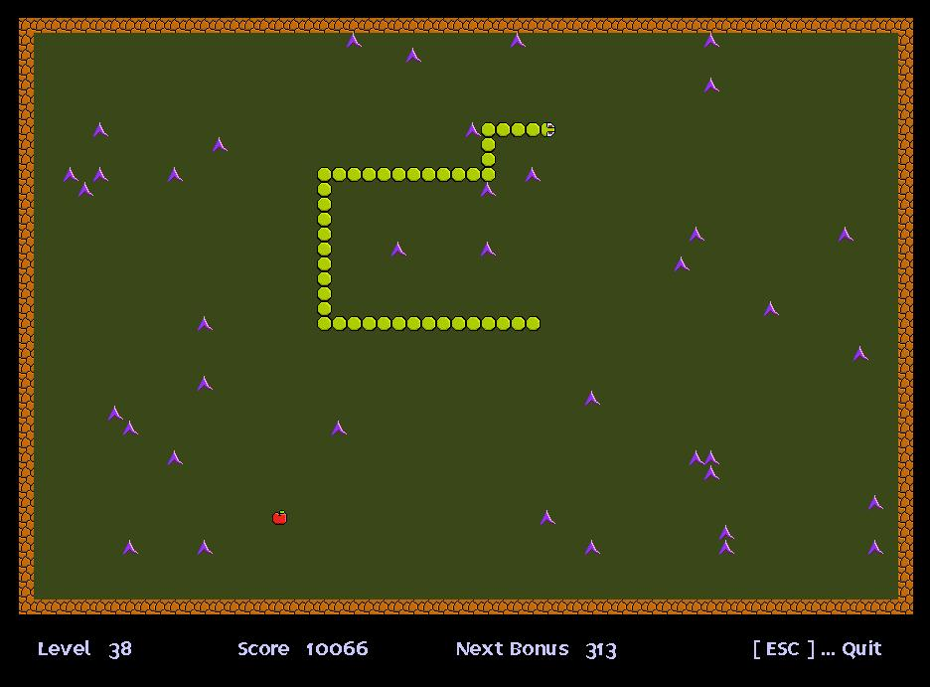
Homework
Create the Snake game using the Revealing module pattern. Design the game such that it has at least three modules.

